Slide 1
Physiological changes at birth
Prof Priyantha Perera

Slide 2
Physiological changes at birth
Baby is dependent on mother for nutrition, gas exchange and waste excretion
After cord is clamped baby should learn to live an independent life
Main and most important changes take place in respiratory system
Cardiovascular changes are secondary to respiratory changes
Changes is GI, Renal and nervous system are more or less adoptations

Slide 3
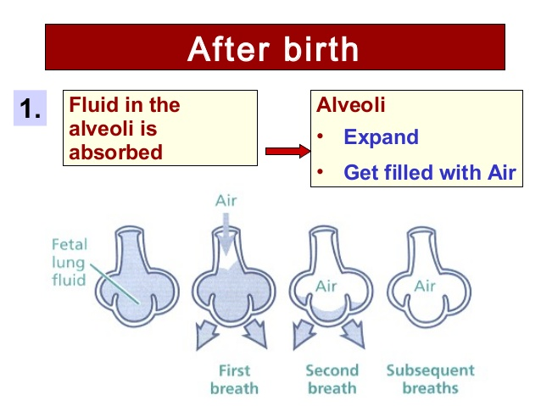
Lung expansion

Slide 4
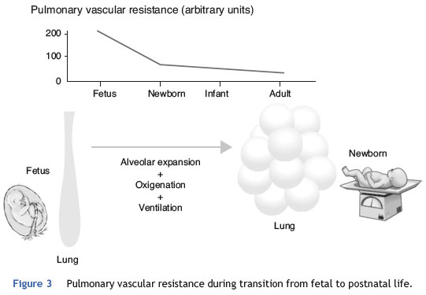
Changes in lungs

Slide 5
Fetal and adult circulations
Fetal circulation id serial
Adult circulation is parallel
Main difference is site of gas exchange
Lungs are not expanded, so no point sending blood to lungs

Slide 6
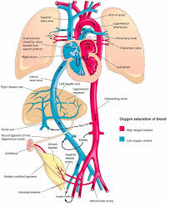
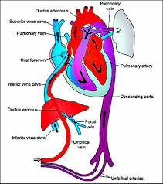
Fetal and adult circulations

Slide 7
What happens if these changes does not take place
Pulmonary pressure will remain high with persistence of foramen ovale and ductus
Right to left shunt result in cyanosis
Right atrium and ventricle dilated
Functional TR
Is called persistent fetal circulation / persistent pulmonary hypertension

